Slide 1
Introduction to Computers and Programming
Chapter 1 – Part 1

Slide 2
Why Program?
Computer – programmable machine designed to follow instructions
Program – instructions in computer memory to make it do something
Programmer – person who writes instructions (programs) to make computer perform a task
SO, without programmers, no programs; without programs, a computer cannot do anything

Slide 3
Main Hardware Component Categories (1 of 2)
Central Processing Unit (CPU)
Main Memory
Secondary Memory / Storage
Input Devices
Output Devices

Slide 4
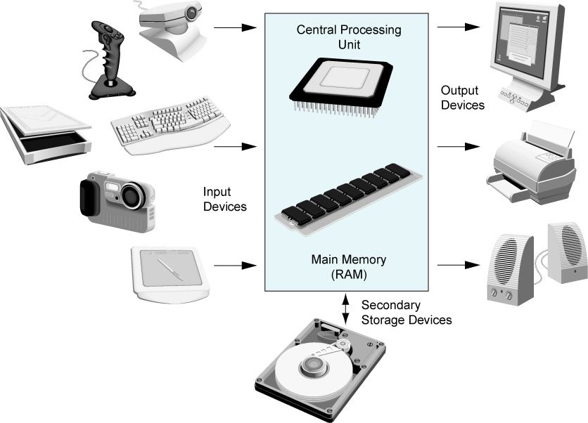
Main Hardware Component Categories (2 of 2)

Slide 5
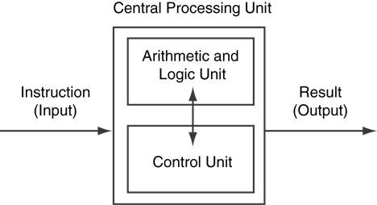
CPU Organization

Slide 6
Main Memory (1 of 3)
It is volatile. Main memory is erased when program terminates or computer is turned off
Also called Random Access Memory (RAM)
Organized as follows:
bit: smallest piece of memory. Has values 0 (off, false) or 1 (on, true)
byte: 8 consecutive bits. Bytes have addresses.

Slide 7
Main Memory (2 of 3)
Addresses – Each byte in memory is identified by a unique number known as an address.

Slide 8
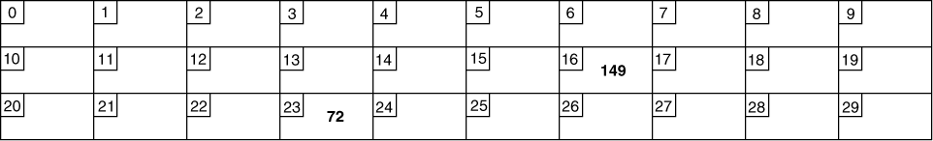
Main Memory (3 of 3)
In the figure above, the number 149 is stored in the byte with the address 16, and the number 172 is stored at address 23.

Slide 9
Secondary Storage
Non-volatile: data retained when program is not running or computer is turned off
Comes in a variety of media:
magnetic: traditional hard drives that use a moveable mechanical arm to read/write
solid-state: data stored in chips, no moving parts
optical: CD-ROM, DVD
Flash drives, connected to the USB port

Slide 10
Input Devices
Devices that send information to the computer from outside
Many devices can provide input:
Keyboard, mouse, touchscreen, scanner, digital camera, microphone
Disk drives, CD drives, and DVD drives

Slide 11
Software-Programs that run on a computer
Categories of software:
System software: programs that manage the computer hardware and the programs that run on them.
Examples: operating systems, utility programs, software development tools
Application software: programs that provide services to the user.
Examples : word processing, games, programs to solve specific problems

Slide 12
Programs and Programming Languages
A program is a set of instructions that the computer follows to perform a task
We start with an algorithm, which is a set of well-defined steps.

Slide 13
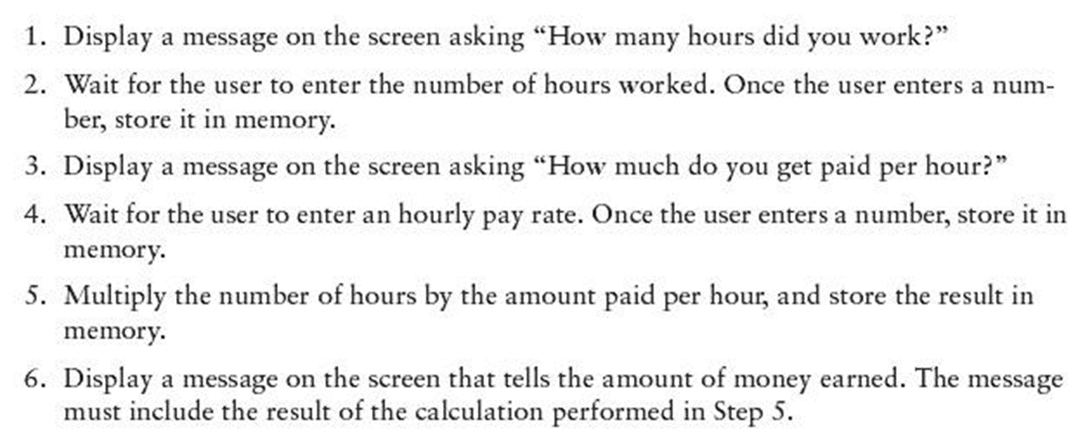
Examples Algorithm for Calculating Gross Pay

Slide 14
Machine Language (1 of 2)
Although the previous algorithm defines the steps for calculating the gross pay, it is not ready to be executed on the computer.
The computer only executes machine language instructions

Slide 15
Machine Language (2 of 2)
Machine language instructions are binary numbers, such as 1011010000000101
Rather than writing programs in machine language, programmers use programming languages.

Slide 16
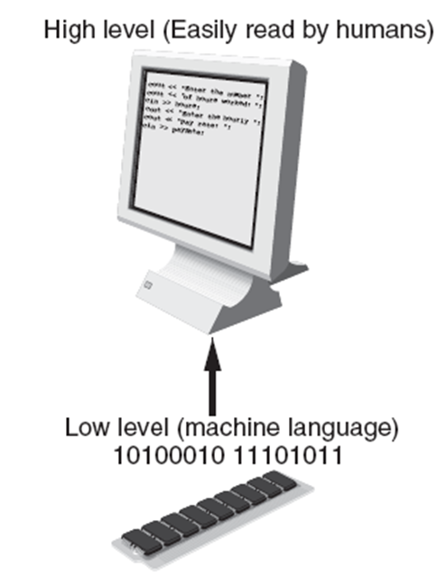
Programs and Programming Languages
Types of languages:
Low-level: used for communication with computer hardware directly. Often written in binary machine code (0’s/1’s) directly.
High-level: closer to human language

Slide 17
From a High-Level Program to an Executable File (1 of 2)
Create file containing the program with a text editor.
Run preprocessor to convert source file directives to source code program statements.
Run compiler to convert source program into machine instructions.
Run linker to connect hardware-specific code to machine instructions, producing an executable file.
Steps b–d are often performed by a single command or button click.
Errors detected at any step will prevent execution of following steps.

Slide 18
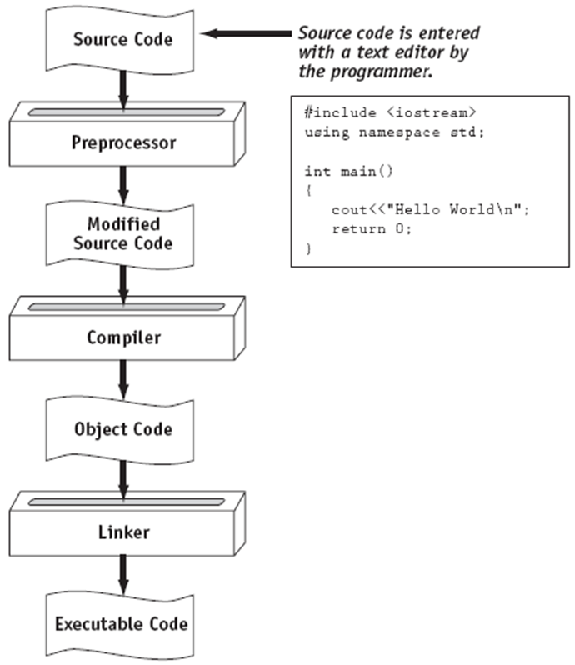
From a High-Level Program to an Executable File (2 of 2)

Slide 19
Keywords, Operators, and Syntax: an overview
Keywords: predefined words used to write program in high-level language
Each key word has specific meaning
Operators: perform operations on data
Example: math operators to perform arithmetic
Syntax: set of rules to be followed when writing program
Statement: individual instruction used in high-level language

Slide 20
Compilers and Interpreters (1 of 3)
Programs written in high-level languages must be translated into machine language to be executed.
Compiler: translates high-level language program into separate machine language program
Machine language program can be executed at any time.

Slide 21
Compilers and Interpreters (2 of 3)
Interpreter: translates and executes instructions in high-level language program
Used by Python language
Interprets one instruction at a time
No separate machine language program
Source code: statements written by programmer
Syntax error: prevents code from being translated.

Slide 22
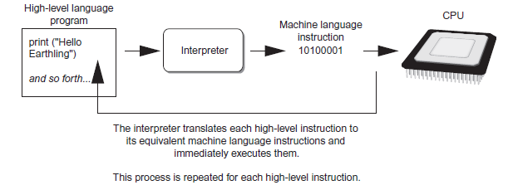
Compilers and Interpreters (3 of 3)

Slide 23
Using Python
Python must be installed and configured prior to use
One of the items installed is the Python interpreter
Python interpreter can be used in two modes:
Interactive mode: enter statements on keyword
Script mode: save statements in Python script

Slide 24
Interactive Mode
When you start Python in interactive mode, you will see a prompt
Indicates the interpreter is writing for a Python statement to be typed
Prompt reappears after previous statement in executed
Error message displayed if you incorrectly type a statement
Good way to learn new parts of Python

Slide 25
Writing Python Programs and Running them in Script Mode
Statements entered in interactive mode are not saved as a program
To have a program use script mode
Save a set of Python statements in a file
The filename should have the .py extension
To run the file, or script, type python filename at the operating system command line

Slide 26
The IDLE Programming Environment
IDLE (Integrated Development Environment): single program that provides tools to write, execute and tests a program
Automatically installed when Python language is installed
Runs in interactive mode
Has built-in text editor with features designed to help write Python programs

Slide 27
What is a Program Made of?
Common elements in programming languages:
Key Words
Programmer-Defined Identifiers
Operators
Punctuation
Syntax

Slide 28
Syntax
The rules of grammar that must be followed when writing a program
Controls the use of key words, operators, programmer-defined symbols, and punctuation

Slide 29
Variables
A variable is a named storage location in the computer’s memory for holding a piece of data.

Slide 30
Input, Processing, and Output
Three steps that a program typically performs:
Gather input data:
from keyboard
from files on disk drives
Process the input data
Display the results as output:
send it to the screen
write to a file

Slide 31
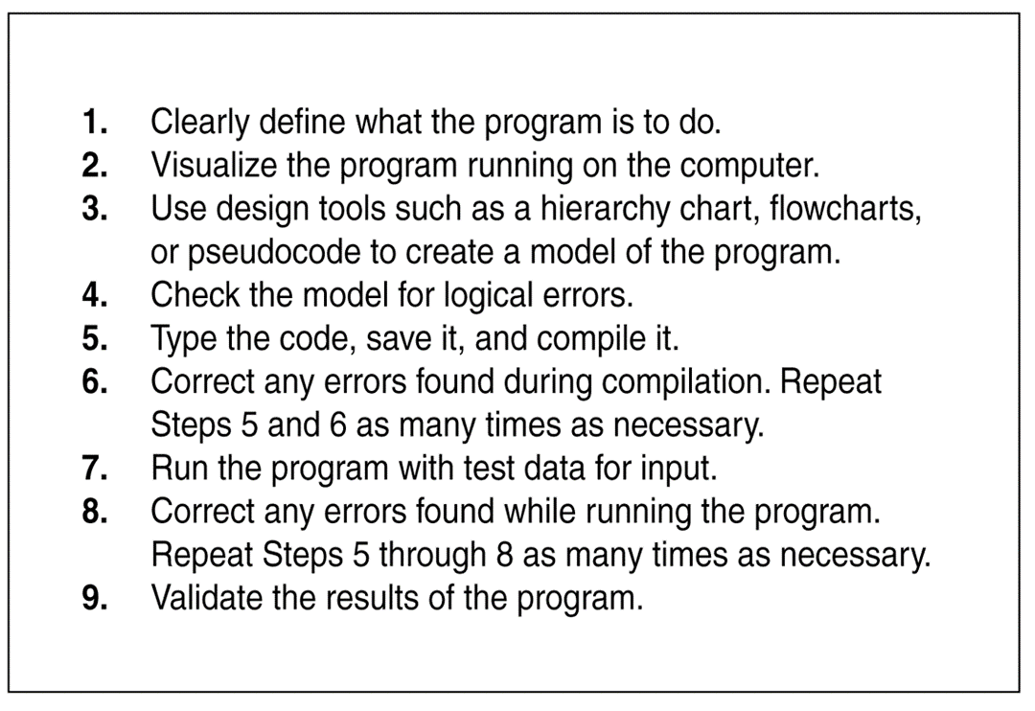
The Programming Process

